Slide 1
THE NECESSITY OF HUMILITY
BQ6 Experts Lesson 10
I can explain why humility is a prerequisite of finding out about the world
Notes:
See how this lesson links to the course by viewing the final slide
Key TOK terms appear in a red font

Slide 2
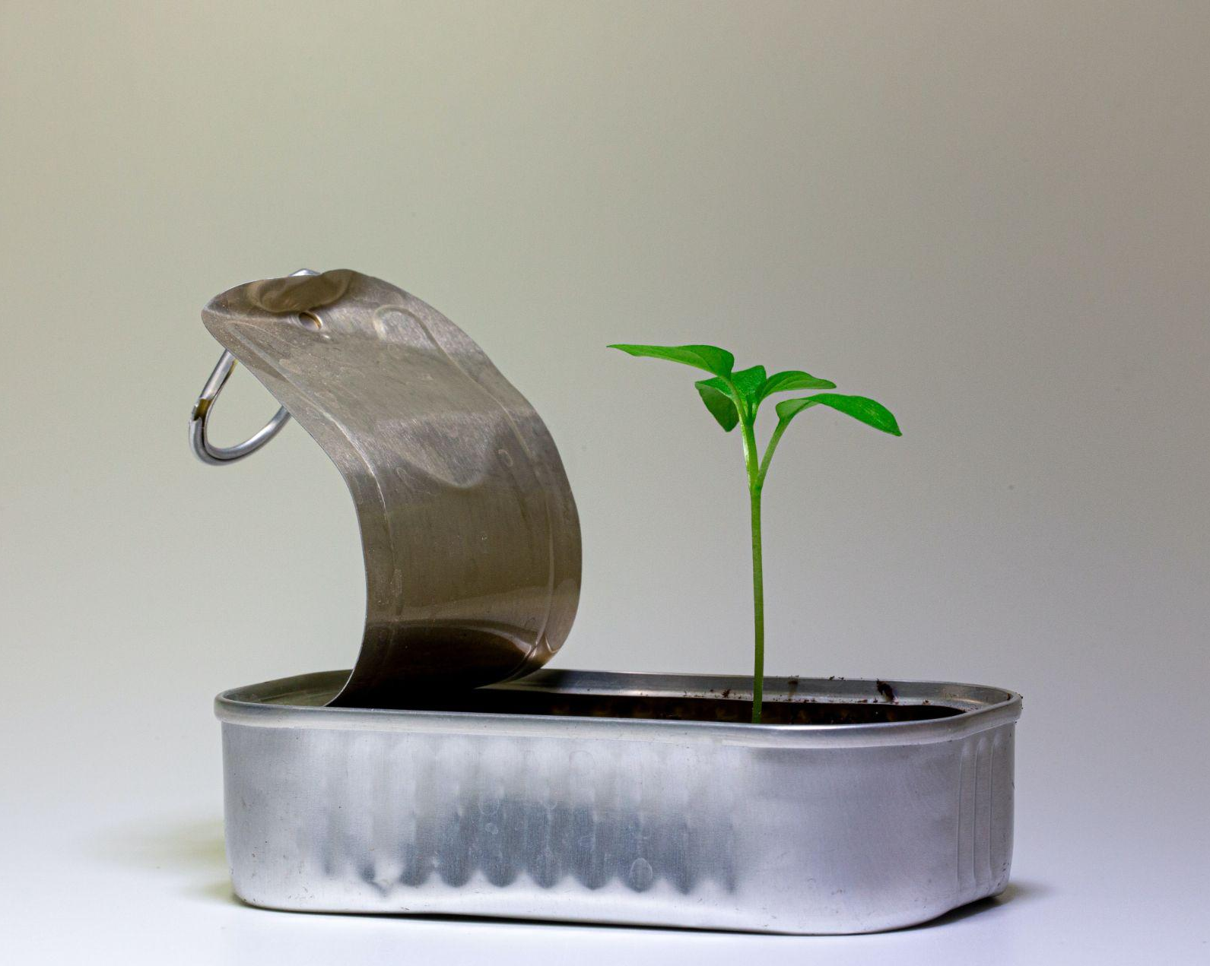
Starter
Which misconceptions or mistakes about the world have you had to correct, in order to develop a more accurate understanding of the world as you have grown older?

Slide 3
Revisiting confirmation bias
Do you remember what Hannah Critchlow said about changing the way we think, in BQ3?
“Once you have built up a perception of the world, you will ignore any information to the contrary… changing the way that you think is going to be quite cognitively costly.”
What did she mean?
What do we tend to do instead of changing our mind - and why can this be a problem?
Notes:
Animated slide. Ask first question, and reveal the quote and questions.
See lesson 3.9 - Seeing what we want to see

Slide 4
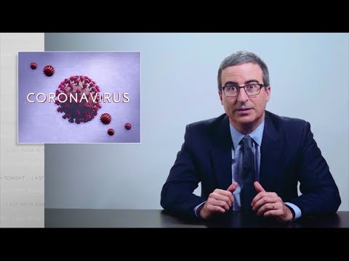
Certainty vs. truth
Watch the clip about the anti-quarantine protests.
Why do these people have such a different interpretation of Covid-19 than majority of society?
What does John Oliver mean when he says that many people have “found it easy to fold this virus into narratives that they've been carefully building up for decades”?
What is a ‘media bubble’ - and why are they hard to escape?
Notes:
Video also here.
Video set to play the right clip (from 1.52 - 3.28).
The narrative is that the liberal forces of America are against the American way of life, want to take away guns, turn the country communist, force people to become vegetarian, etc., etc.
Our media bubble is our ‘echo-chamber’ - and we’re often reluctant to venture out of that (on social media as well as on news media). We don’t like having our beliefs challenged - it’s much easier (ie less ‘cognitively costly’) to hang around with those who reflect our own values and beliefs. These people in the video are an example of that, to a self-destructive level (their actions are going to lead to a longer, not a shorter, lock-down), but those on the other side of the political spectrum group together similarly (though perhaps not quite as self-destructively).
The whole of the video is worth watching, but note that it contains a lot of expletives!
If you want an alternative video - try this one.

Slide 5
Table groups: combatting confirmation bias
Get together in groups and discuss how willing YOU are to admitting that you have made a mistake, and changing your ideas, opinions, and beliefs.
In what areas is it harder to do this, and in what areas are you able to change your mind in a less ‘cognitively costly’ way?
Write down your ideas on large sheet of paper (save some space for the idea coming up next…).

Slide 6
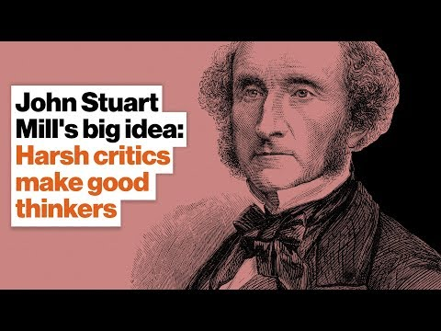
Keith Whittington on John Stuart Mill
How does Whittington connect Mill’s approach to knowledge to: a) humility, b) arrogance, and c) conviction?
What did Mill suggest we do if we want to have confidence in our beliefs and opinions (especially the ones we care about the most)?
Add the thoughts you’ve written to your shared display sheet.
Notes:
Video link also here.
We have to have humility in order to accept that we may have made a mistake - without this, we’ll never learn anything.
We have to avoid arrogance in terms of refusing ideas we dislike to circulate and ‘pollute’ other people’s ways of thinking.
If we are truly convinced of an idea, we should be willing to let it be vigorously challenged, in order to see if it stands up to the scrutiny.
So, the ideas we care about the most should be the ones we are willing to test the most harshly.

Slide 7
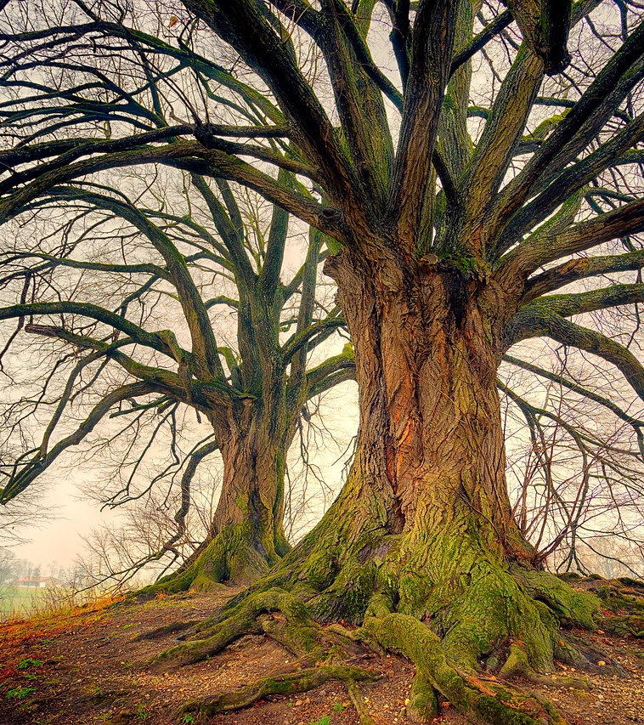
A case study in humility
Read the article about accepting advice on managing the world's natural resources.
How would you link this to the concept of humility?
From this article, and other sources, how important is it to change our approach to managing the natural world?
Notes:
Optional slide.
The article discusses the fact that large scale, industrialized societies need help in managing the environment - specifically from indigenous groups. Their inability to admit and do this links to a lack of humility that they may have gotten things wrong (and caused huge damage to the natural world). If we applied more humility, we might realize the problem, and be able to improve the situation.
The article links to indigenous societies, the natural sciences, and politics.

Slide 8
Links to the TOK exhibition
Related exhibition prompt Does our knowledge depend on our interactions with other knowers? (IAP-26)
Refer to the ideas from this lesson to answer this question.
For example, think about how genuinely listening to the ideas of others - and being willing to accept that they may be right, and we may be wrong - moves our knowledge onwards.
Which objects could help to illustrate your answer?
Notes:
Optional slide, if you want to help students to take ownership of the IA prompts (IAPs) for the TOK exhibition

Slide 9
What role does humility play in the production of new knowledge - on both a personal and a societal level?
Notes:
See the BQ6 assessment tracker for suggestions on providing feedback, and recording students’ progress.

Slide 10
Linking this lesson to the course
During this lesson, we consider the highlighted aspects of the TOK course
The images used in the presentation slides can also give students ideas about selecting exhibition objects; see also our link below to specific IA prompts
CORE THEME | OPTIONAL THEMES | AREAS OF KNOWLEDGE | TOK ASSESSMENT
Knowledge & the knower | Indigenous societies | The arts | The TOK essay
 | Language | History
 | Politics | The human sciences | The TOK exhibition Could be linked to IAP-8 (certainty), IAP-11 (beliefs), IAP-26 (interactions)
 | Religion | Mathematics
 | Technology | The natural sciences

Slide 11
Explore the TOK themes and areas of knowledge in more depth via a range of thinkers, media sources, and other resources, in our EXPLORATION POINTS DOCUMENTS.
Access the documents via the links below. You’ll also find the EP icons on all of the TOK course pages of the site to help you unpack the quotes, KQs, and real-life situations that you find there.
CORE THEME
Knowledge & the knower
OPTIONAL THEMES
Indigenous societies
Language
Politics
Religion
Technology
AREAS OF KNOWLEDGE
The arts
History
Human sciences
Mathematics
Natural sciences
Notes:
Use this slide to access the ‘Exploration Points’ notes for BQ6, which will help students to develop a deeper knowledge of any TOK theme or area of knowledge. This will not only help them to master the TOK course in general, but also craft a great exhibition or essay.
Be ready to provide more guidance on how to use this resource - ie, which media sources to focus on, which questions to address, which TED talks to watch, and which key terms and ideas to understand.

